Slide 1
IBM Data Science Capstone
Project
Best Venues for a Newbie

Slide 2
Business Problem
A Techie who wants to settle in Bangalore,needs good hotel for a temporary stay, best TechPark to kick start a career, restaurants near-by and the best automotive shop in Bengaluru(Bangalore).
A model was requested to be built which would showcase the above requirements.

Slide 3
Requirement Specification
The program should have:
Top 5 Restaurants in Bangalore, where the categories of the restaurants should include varied interests, with the required amenities.
1 comfortable hotel to check in temporarily.
1 impressive TechPark having diverse IT firms in it.
Automotive shop that contains rental provisions and workshop in case of repair.
Top 5 PGs for a long term stay.
Nevertheless a map specifying all these places of interest was to be generated.

Slide 4
Requirements Gathering
Data used for the leverage of output was entirely the data provided by the Foursquare API.
Clustering of data is done on the basis of the area.
Every area specified in the cluster includes the data of the restaurants, PG, hotel,TechPark and automotive shop.

Slide 5
Methodology
Libraries and Foursquare credentials are definied.
Longitude and Latitude of the city is obtaine using the Foursquare API.
Depending on teh requirement, varied cases are developed to obtain the required Data.

Slide 6
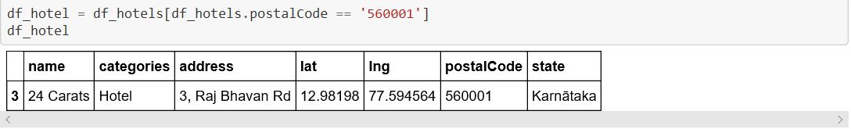
CASE 1: Hotel
Search query is initiated for the 'Hotel'.
Results are represented in Dataframes.
Data is cleaned for better understanding, based on the category.
Best hotel is represented in Dataframe, with reference to the postal code.

Slide 7
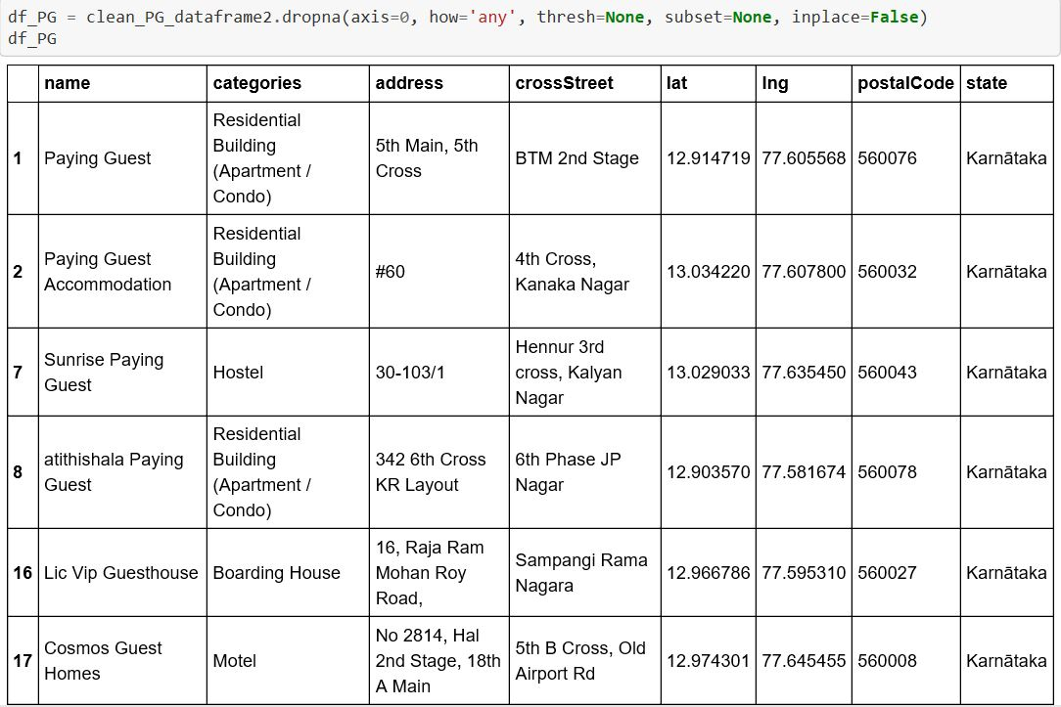
CASE 2: Paying Guest Venues
Begin a search query for PG Venues within a specified radius.
Transform the data into the Dataframe.
Clean the data and represent it the cleaned data in a Dataframe.

Slide 8
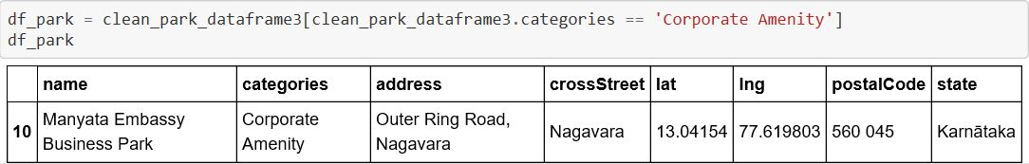
CASE 3: Tech-Park
Search query is initiated for the 'Park'.
Results are represented in Dataframes.
Data is cleaned by categorising the Corporate Aminities.
Best tech-park is represented in Dataframe, along with the postal code.

Slide 9
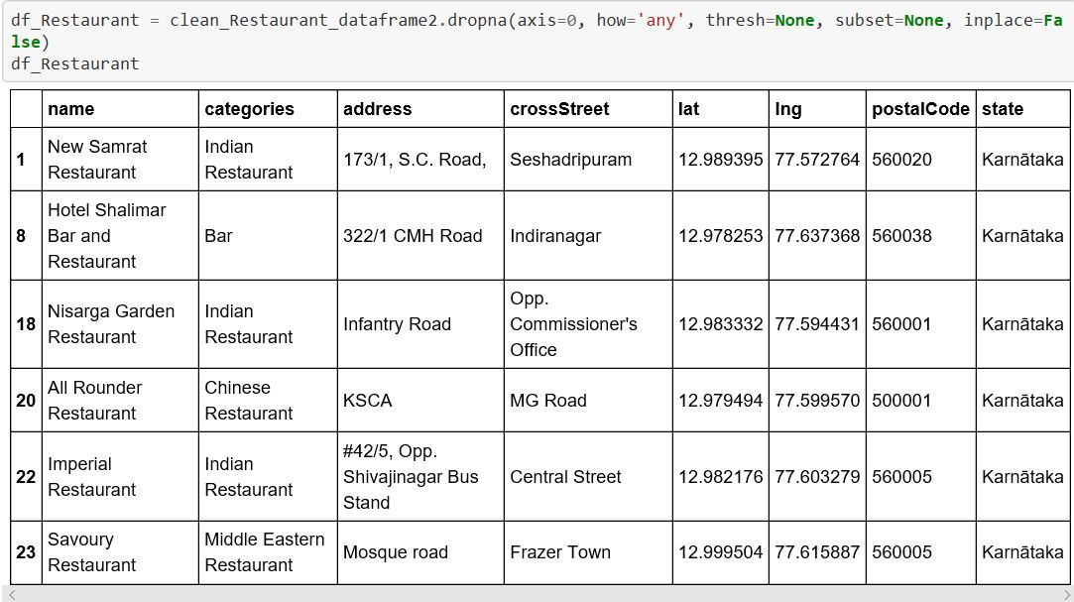
CASE 4: Restaurants
Search query for Restaurants is given.
Transform the data into the Dataframe.
Clean the data and represent it the cleaned data in a Dataframe, which includes all the flavours of the restaurants apart from Indian.

Slide 10
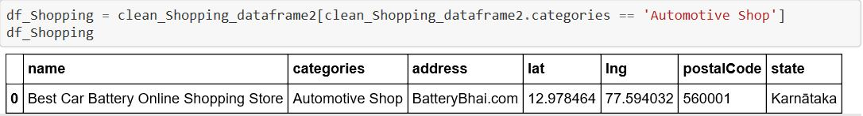
CASE 5: Automotive shop
Search query is initiated for the 'shop'.
Results are represented in Dataframes.
Data is cleaned to represent an automotive shop.
Best automotive is represented in Dataframe, along with the website.

Slide 11
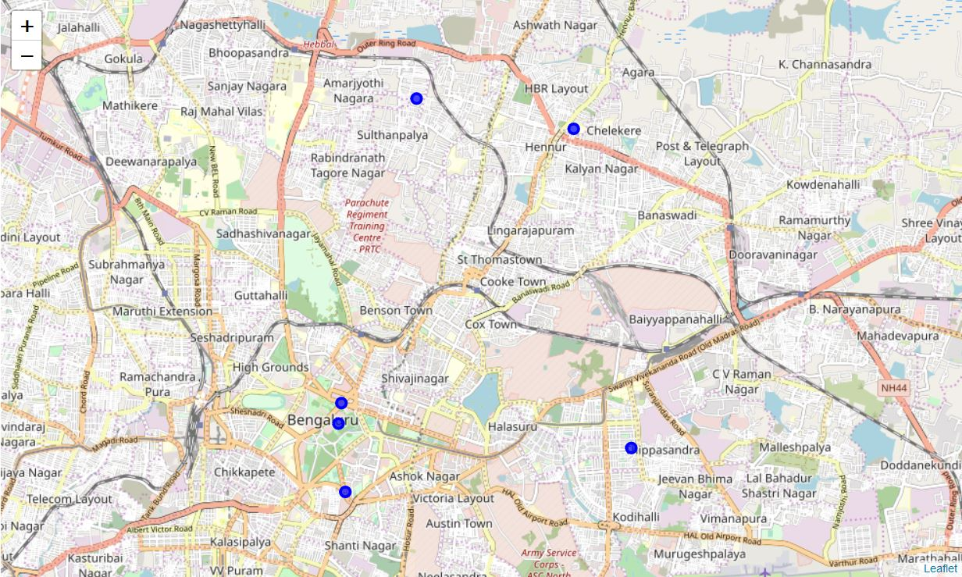

Clustering and Data Visualization
The results obtained were two clusters of different domains put together under certain scenarios.
Scenario 1:
The techie initially needs a nearest comfortable hotel for temporary stay, an automotive shop to hire a car from and a PG for a long stay. This is represented by the first cluster:

Slide 12
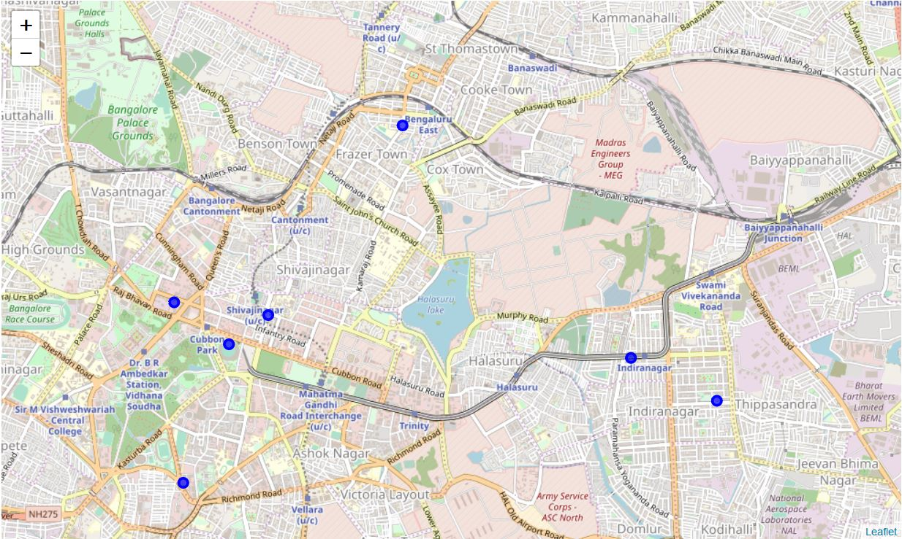
Scenario 2:
After settling down, the techie needs to find a new PG, a techpark to kick-start his career and near-by restaurants for the refreshments. This is represented by the clusters:

Slide 13
Conclusion and Future Scope
It is interesting to note how the two clusters can provide the customer with varied locations.
Further developments can be made using the ML algorithms, to bring out the best locations for all the categories specified by the customer.
Distance covered each day by from each of the clusters.
Recommendation models can be built to suggest for the best cost and comfortable places based on the money invested by the customer.

Slide 14
By the study of the data we can conclude that Bangalore being and IT hub, provides lots of scope for the IT professionals.
Lodging and recreation is not an issue in the city.
The 24 carats hotel proves to be the best hotel, with fastest means of commute(metro).
6 Paying Guest accommodations as requested by the techie, Manyata Embassy Business park being a good place with many IT companies to kick start a career with.
6 good restaurants for recreation.
Best automotive shop for repair of cars, given by its website.
the above are the conclusions of the project.
Clustering provides a detailed study of each location which is visually a treat.

Slide 15
THANKYOU

